Slide 1
COMP9414 Tutorial
Week 9

Slide 2

News
Assignment 2 is due tomorrow at midnight
Week 9, Friday, July 31st, 11:59pm
Ignore questions 2ii, 2iii and 2iv from tutorial 8
Wayne didn’t want us to go over it
No idea why he included it

Slide 3
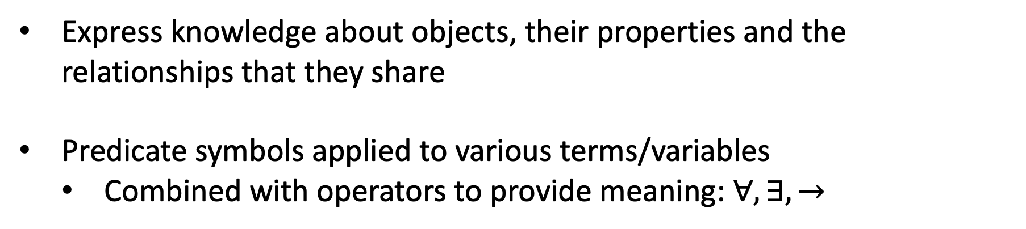
First-order Logic
Express knowledge about objects, their properties and the relationships that they share
Predicate symbols applied to various terms/variables
Combined with operators to provide meaning: $∀, ∃, →$

Slide 4
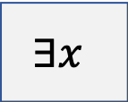
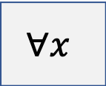


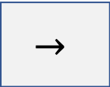
First-order Logic - Operators
$$∀x$$
Universal
For all x
$$∃x$$
Existential
At least one x
$$→$$
Binary Connective
Leads to or is true as a result
Equality
$$=, ≠, ≤, ≥$$
Logical Connectives
$$∧, ∨, →,↔,¬$$

Slide 5


First-order Logic – Basic Examples
Term
Predicate
Operator
Someone likes James
$$∃x likes(x, James)$$
The $∀$ symbol generally involves a $→$ symbol.
All people are mortal
$$∀x (person\left(x\right)→mortal\left(x\right))$$
The $∃$ symbol generally involves a $∧$ symbol.
All cats are immortal
$$∃x (cat\left(x\right)∧¬mortal\left(x\right))$$

Slide 6
First-order Logic – Equivalency Examples
Term
Predicate
Operator
Every student took an exam
$$∀x (student\left(x\right)→∃y(exam\left(y\right) ∧took\left(x,y\right)))$$
Every student took an exam
$$∃y (exam\left(y\right)∧∀x \left(student\left(x\right)→took\left(x,y\right))\right)$$
Brothers are siblings
$$∀x ∀y (brothers\left(x, y\right)→sibling\left(x, y\right))$$
Siblings
$$∃x ∃y (sibling\left(x, y\right)↔sibling\left(y, x\right))$$

Slide 7
First-order Logic – Nested Quantifier Examples
Term
Predicate
Operator
Everything likes everything
$$∀x ∀y likes\left(x, y\right)$$
Something likes something
$$∃x ∃y likes\left(x, y\right)$$
Everything likes something
$$∀x ∃y likes\left(x, y\right)$$
Something liked by everything
$$∃x ∀y likes\left(x, y\right)$$

Slide 8
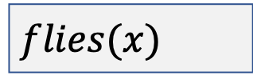
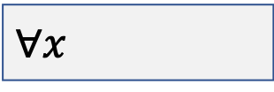
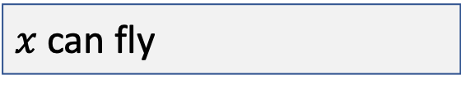
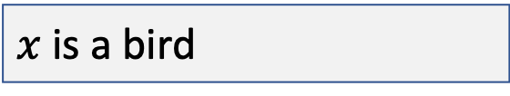
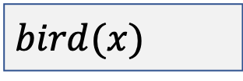
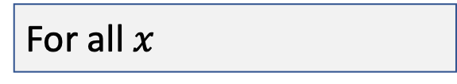
Question 1i
$$∀x (bird\left(x\right)→flies\left(x\right))$$
$$∀x$$
For all $x$
$$bird(x)$$
$x$ is a bird
$$flies(x)$$
$x$ can fly
For all $x$, $x$ is a bird implies that $x$ can fly
All birds can fly

Slide 9
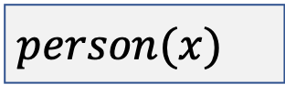
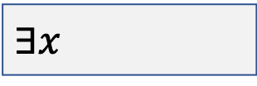
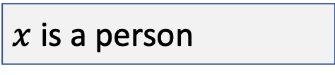
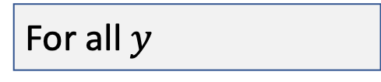
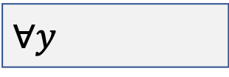
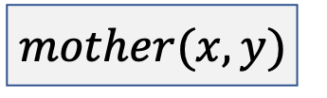
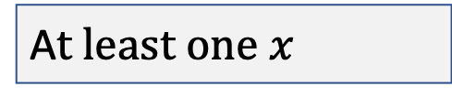
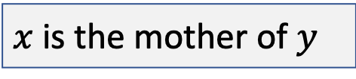
Question 1iii
$$∃x ∀y (person\left(x\right)∧mother\left(x, y\right))$$
$$∃x$$
A$t least one x$
$$person(x)$$
$x$ is a person
$$∀y$$
For all $y$
$$mother(x,y)$$
$x$ is the mother of $y$
At least one $x$, for all $y$, $x$ is a person and the mother of $y$
There is someone who is everyone’s mother

Slide 10
Question 2i
$$All cats are mammals$$
Terms
N/A
Quantifiers
All
Predicates
cats, mammals
Operators
are
$$∀x (cat\left(x\right)→mammal\left(x\right))$$

Slide 11
Question 2iii
All computer scientists like some operating system
Terms
N/A
Quantifiers
All, some
Predicates
computer_scientist, operating_system, likes
Operators
N/A
$$∀x (computer_scientist\left(x\right)→∃y (operating_system\left(y\right)∧likes(x, y)))$$

Slide 12
Background – Conjunctive Normal Form (CNF)
Conjunction of disjunctive literals
(A ∨ B) ∧ (C ∨ D) ∧ (E ∨ F ∨ G) ∧ H
{A ∨ B, C ∨ D, E ∨ F ∨ G, H}
Grammar = {predicates, literals, conjunctions, disjunctions, internal negations}
Example | Conjunctive Normal Form
(A ∨ B) ∧ (C ∨ D) | Yes
(A ∨ ¬B) ∧ C ∧ (¬D ∨ E) | Yes
(A ∨ ¬B) ∧ C ∨ (¬D ∨ E) | No
(A → ¬B) ∧ ¬(D ∨ E) | No

Slide 13
CNF Rules - Distribution Changes
Change a conjunction into a disjunction and vice-versa
Flip centre connective and distribute left predicate literals with right predicate
Example | Distribution Change
(A ∧ B) ∨ C | (A ∨ C) ∧ (B ∨ C)
(A ∨ B) ∧ C | (A ∧ C) ∨ (B ∧ C)

Slide 14

CNF Rules – Negation Changes (De Morgan)
Moving negation inwards
$$¬\left(∀x p\right)≡ ∃x ¬p$$
When the negation is applied, universal/existential quantifiers and equal/not equal signs are flipped
$$¬\left(∃x p\right)≡ ∀x ¬p$$
$$¬\left(likes\left(x,y\right)∧(y≠z)\right)≡¬likes\left(x,y\right)∨y=z$$
$$¬\left(A∨B\right)≡ ¬A∧¬B$$
$$¬\left(A∧B\right)≡ ¬A∨¬B$$
Double negation
$$¬¬A≡ A$$
$$¬\left(y≠z\right)≡\left(y=z\right)$$

Slide 15
CNF Rules - Implication
A → B is equivalent to ¬A ∨ B
A | B | A → B | ¬A ∨ B
T | T | T | T
T | F | F | F
F | T | T | T
F | F | T | T

Slide 16
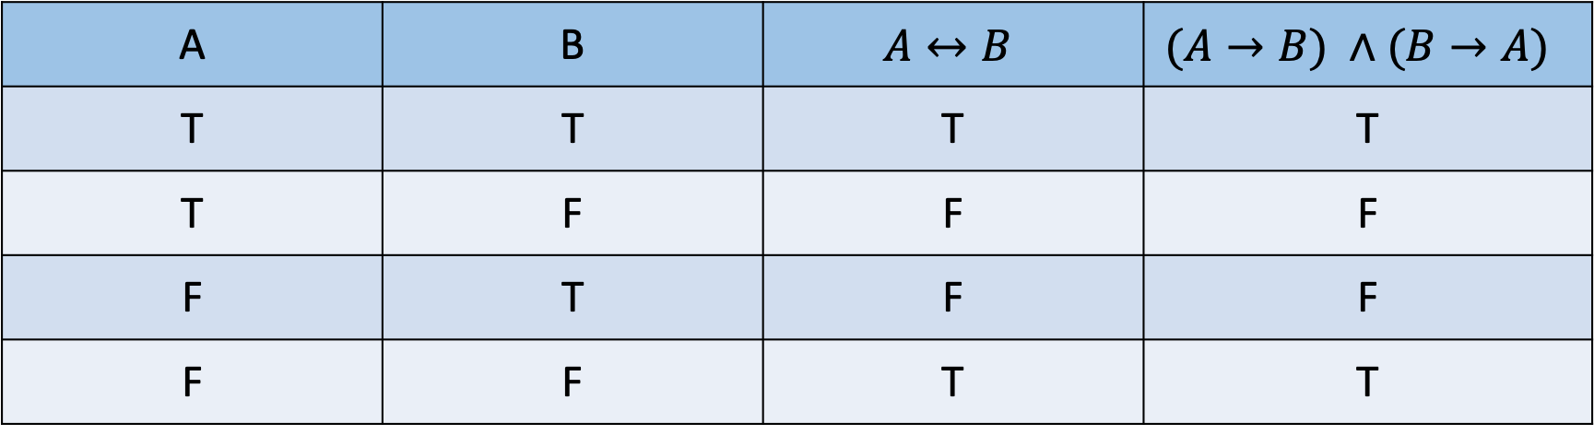
CNF Rules – Bi-implication
$A↔B$is equivalent to $(A→B) ∧(B→A)$
A | B | $$A↔B$$ | $$(A→B) ∧(B→A)$$
T | T | T | T
T | F | F | F
F | T | F | F
F | F | T | T

Slide 17
CNF Conversion steps
1
Eliminate all bi-implication and implications
2
Move all negations inwards and correct double negations

Slide 18




CNF Conversion steps
3
Rename variables to ensure each quantifier has a unique one
No convention with the naming, just choose a different letter.
Adding a subscript number is fine as well, $x ≈x_{0}$
Examples
$$∀x P\left(x\right)∨ ∃x Q(x)$$
$$≈$$
$$∀x P\left(x\right)∨ ∃y Q(y)$$
$$∀x A\left(x\right)∧ ∃x B\left(x\right)∧∀x C(x)$$
$$≈$$
$$∀x_{0} A\left(x_{0}\right)∧ ∃x_{1} B\left(x_{1}\right)∧∀x_{2} C(x_{2})$$

Slide 19


CNF Conversion steps
4
Replace each existential quantifier ($∃$) with a Skolem constant
Basically remove the quantifier and wrap its variable in some arbitrary predicate
Case 1
Existential quantifier is at the outermost level (no parent)
Replace all occurrence of the variable with an arbitrary constant
Examples
$$∃x Q(x)$$
$$≈$$
$$Q(s_{0})$$

Slide 20
CNF Conversion steps
4
Replace each existential quantifier ($∃$) with a Skolem constant
Basically remove the quantifier and wrap its variable in some arbitrary predicate
Case 2
Existential quantifier is wrapped in a Universal quantifier
Replace all occurrence of the variable with a predicate whose parameters include the universal quantifier variables

Slide 21
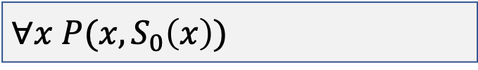




CNF Conversion steps
Case 2
Existential quantifier is wrapped in a Universal quantifier
Examples
$$∀x ∃y P(x, y)$$
$$≈$$
$$∀x P(x, S_{0}\left(x\right))$$
$$∀x_{0}…∀x_{n} ∃y P(x_{0}, …,x_{n}, y)$$
$$≈$$
$$∀x_{0}…∀x_{n} P(x, { S}_{0}\left(x_{0}, …,x_{n}\right))$$

Slide 22


CNF Conversion steps
5
Drop all universal quantifiers
Basically just remove them all, no other changes are necessary
Examples
$$∀x Person\left(x\right)$$
$$≈$$
$$Person\left(x\right)$$

Slide 23
CNF Conversion steps
6
Arrange the $∧$ and $∨$ connective to match conjunctive normal form
Just used the basic CNF rules in the previous slides, nothing special is required from this point onwards

Slide 24
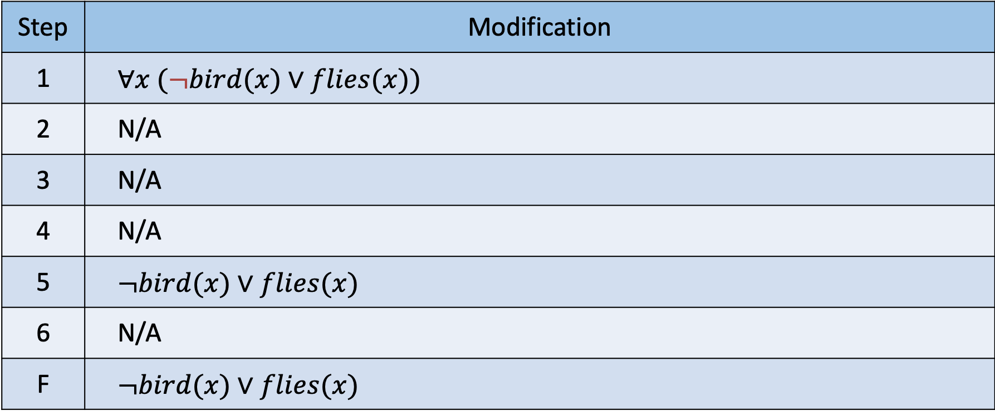
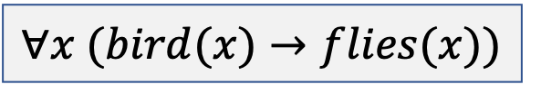
Question 3i
$$∀x (bird(x)→flies(x))$$
Step | Modification
1 | $$∀x (¬bird(x)∨flies(x))$$
2 | N/A
3 | N/A
4 | N/A
5 | $$¬bird(x)∨flies(x)$$
6 | N/A
F | $$¬bird(x)∨flies(x)$$

Slide 25
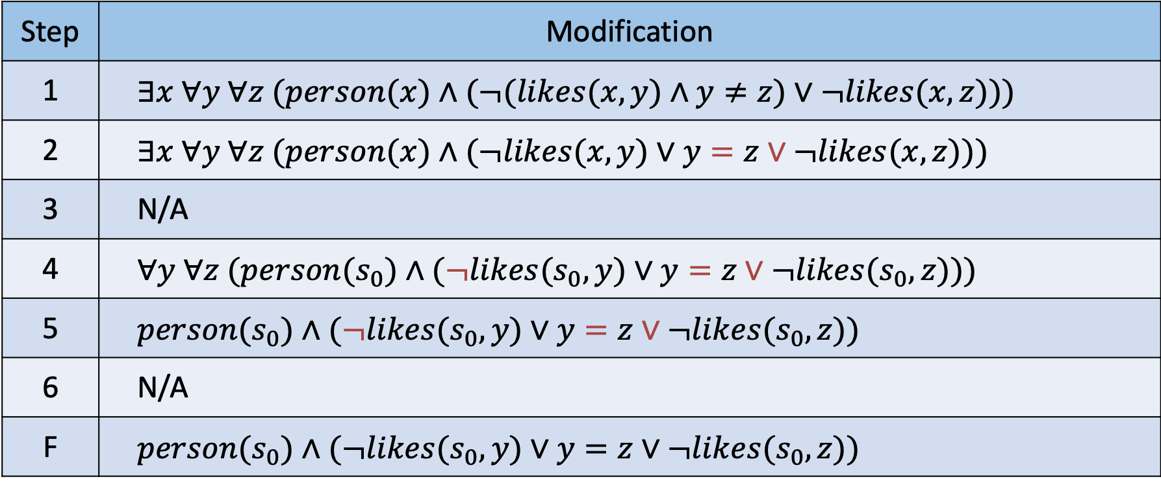
Question 3ii
$$∃x ∀y ∀z (person(x)∧((likes(x,y)∧y≠z)→¬likes(x,z)))$$
Step | Modification
1 | $$∃x ∀y ∀z (person(x)∧(¬(likes(x,y)∧y≠z)∨¬likes(x,z)))$$
2 | $$∃x ∀y ∀z (person(x)∧(¬likes(x,y)∨y=z∨¬likes(x,z)))$$
3 | N/A
4 | $$∀y ∀z (person(s_{0})∧(¬likes(s_{0},y)∨y=z∨¬likes(s_{0},z)))$$
5 | $$person(s_{0})∧(¬likes(s_{0},y)∨y=z∨¬likes(s_{0},z))$$
6 | N/A
F | $$person(s_{0})∧(¬likes(s_{0},y)∨y=z∨¬likes(s_{0},z))$$

Slide 26
Background – Resolution Rule
Create a new clause from two other clauses containing complementary literals
Clause 1 | Clause 2 | New Clause
¬Q ∨ P | Q ∨ P | P
¬Q ∨ R | ¬R | ¬Q

Slide 27
Background – Resolution Rule
Create a new clause from two other clauses containing complementary literals
Clause 1 | Clause 2 | New Clause
{¬Q, P} | {Q, P} | {P}
{Q, R} | {¬R} | {¬Q}

Slide 28
Background – Resolution Refutation Steps
Determine what predicates in the clauses refute the proof
1
Negate the derivation
2
Convert all clauses to conjunctive normal form (CNF)
Including the derivation
3
Continually apply the resolution rule
Basically just combining clauses until all predicates are cancelled

Slide 29
Original Resolution Example
(P ∨ Q), P → R, Q → R ⊢ R
# | Original | Operation | Result
1 | R | Conclusion Negation | ¬R
2 | (P ∨ Q) | CNF Conversion | P ∨ Q
3 | P → R | CNF Conversion | ¬P ∨ R
4 | Q → R | CNF Conversion | ¬Q ∨ R
{¬R, P ∨ Q, ¬P ∨ R, ¬Q ∨ R}

Slide 30
Original Resolution Example
(P ∨ Q), P → R, Q → R ⊢ R
# | Original | Operation | Result
5 | P ∨ Q, ¬P ∨ R | Resolution rule 2, 3 | Q ∨ R
6 | ¬R, ¬P ∨ R | Resolution rule 1, 3 | ¬P
7 | ¬R, ¬Q ∨ R | Resolution rule 1, 4 | ¬Q
8 | Q ∨ R, ¬Q | Resolution rule, 5, 7 | R
9 | ¬R, R | Resolution rule, 1, 8 | .
{¬R, P ∨ Q, ¬P ∨ R, ¬Q ∨ R}

Slide 31
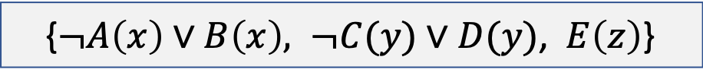

Background – Resolution Refutation Differences
1
Rename variables to ensure they are unique amongst CNF clauses
Once all clauses have been converted to CNF based on their quantifiers
Example
{$¬A\left(x\right)∨B\left(x\right), ¬C(x)∨D(x)$, $E\left(x\right)$}
$$≈$$
{$¬A\left(x\right)∨B\left(x\right), ¬C(y)∨D(y)$, $E\left(z\right)$}

Slide 32
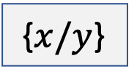
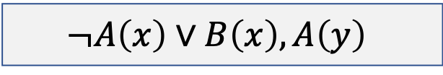
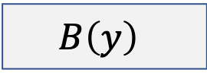

Background – Resolution Refutation Differences
2
Variables can be substituted to resolve their predicates
Example
$$¬A\left(x\right)∨B\left(x\right), A\left(y\right)$$
$$≈$$
{$x/y$}
$$B\left(y\right)$$

Slide 33
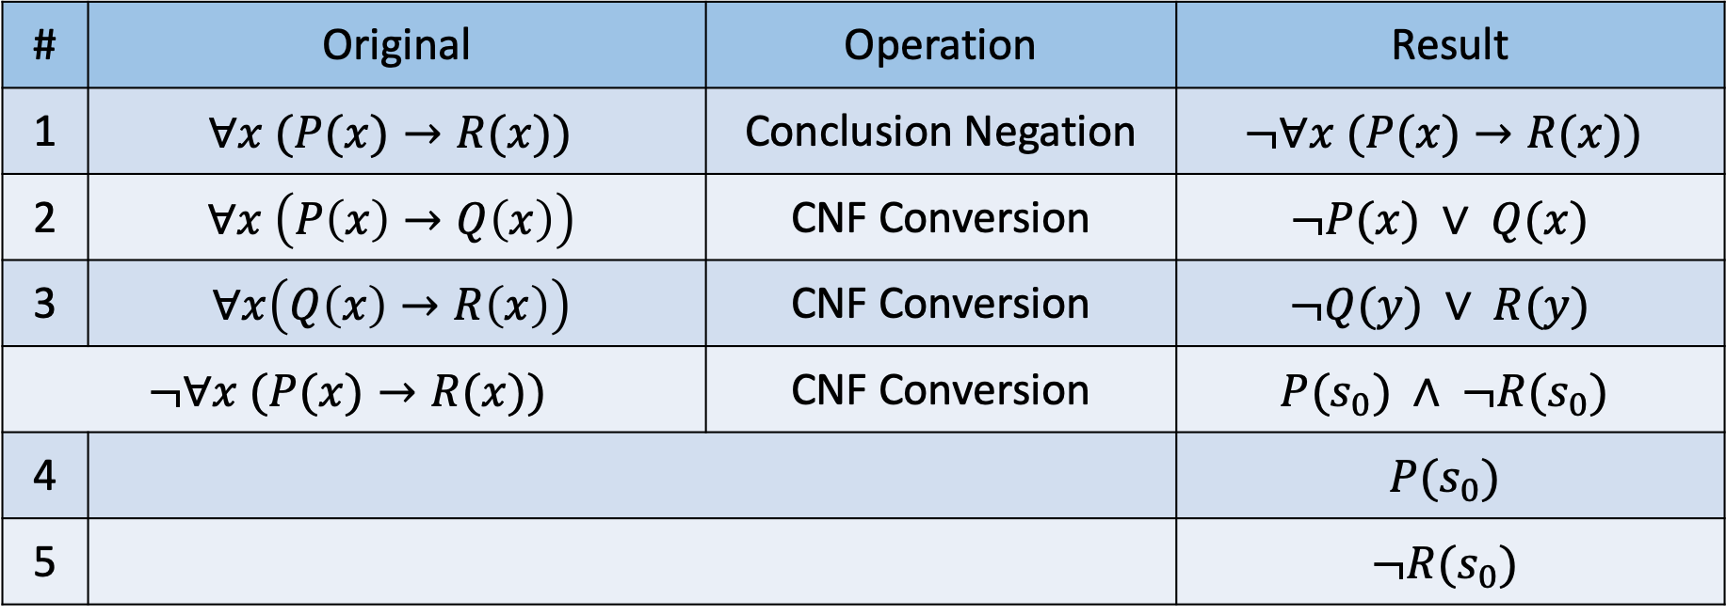
Question 4v
$$∀x \left(P\left(x\right)→Q\left(x\right)\right), ∀x\left(Q\left(x\right)→R\left(x\right)\right)⊢∀x (P(x)→R(x))$$
# | Original | Operation | Result
1 | $$∀x (P(x)→R(x))$$ | Conclusion Negation | $$¬∀x (P(x)→R(x))$$
2 | $$∀x \left(P\left(x\right)→Q\left(x\right)\right)$$ | CNF Conversion | $$¬P(x) ∨ Q(x)$$
3 | $$∀x\left(Q\left(x\right)→R\left(x\right)\right)$$ | CNF Conversion | $$¬Q(y) ∨ R(y)$$
$$¬∀x (P(x)→R(x))$$ |  | CNF Conversion | $$P(s_{0}) ∧ ¬R(s_{0})$$
4 |  |  | $$P(s_{0})$$
5 |  |  | $$¬R(s_{0})$$

Slide 34
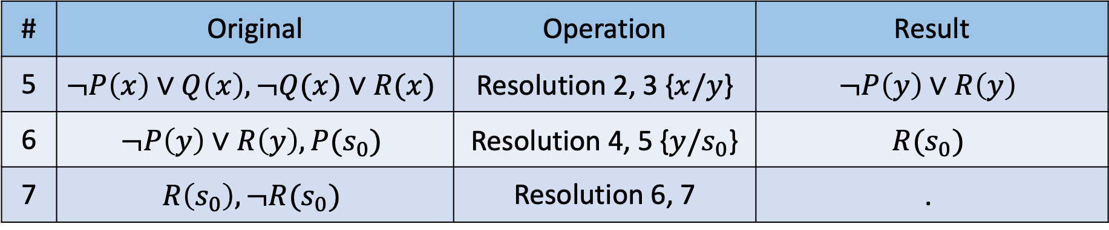
Question 4v
$$∀x \left(P\left(x\right)→Q\left(x\right)\right), ∀x\left(Q\left(x\right)→R\left(x\right)\right)⊢∀x (P(x)→R(x))$$
# | Original | Operation | Result
5 | $$¬P\left(x\right)∨Q\left(x\right), ¬Q(x)∨R(x)$$ | Resolution 2, 3 {$x/y$} | $$¬P\left(y\right)∨R\left(y\right)$$
6 | $$¬P\left(y\right)∨R\left(y\right),P(s_{0})$$ | Resolution 4, 5 {$y/s_{0}$} | $$R(s_{0})$$
7 | $$R\left(s_{0}\right), ¬R(s_{0})$$ | Resolution 6, 7 | .
{$¬P\left(x\right)∨Q\left(x\right), ¬Q(y)∨R(y)$, $P\left(s_{0}\right), ¬R(s_{0})$}

Slide 35
Question 5i
1
There is a computer scientist who likes every operating system
$$∃x (cs(x)∧∀y \left(os\left(y\right)→likes(x,y\right))$$
2
Linux is an operating system
$$os(Linux)$$
3
Someone likes Linux
$$∃z likes(z, Linux)$$

Slide 36
Question 5ii
Basically convert to CNF
1
$$∃x (cs(x)∧∀y \left(os\left(y\right)→likes(x,y\right))$$
$$cs\left(s_{0}\right)∧(¬os(y)∨likes(s_{0}, y))$$
2
$$os(Linux)$$
$$os(Linux)$$
3
$$∃z likes(z, Linux)$$
$$¬likes(z, Linux)$$

Slide 37

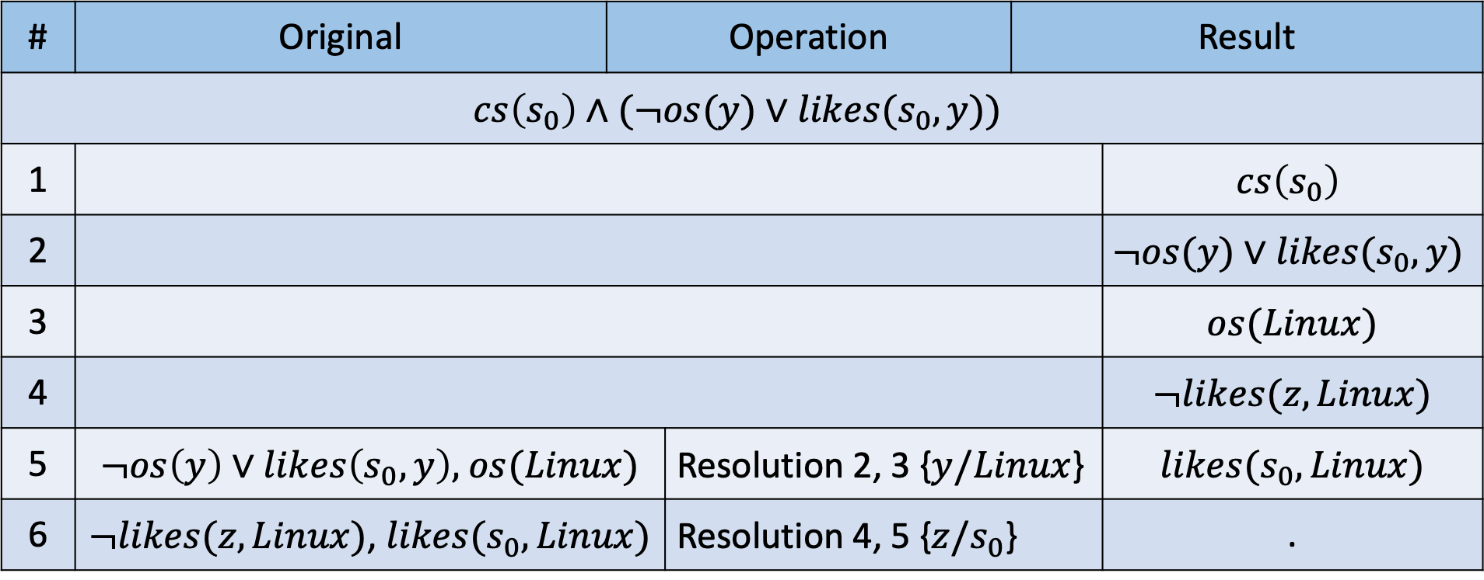
Question 5iii
$$A, B, ¬C$$
# | Original | Operation |  | Result
$$cs\left(s_{0}\right)∧(¬os(y)∨likes(s_{0}, y))$$
1 |  |  |  | $$cs\left(s_{0}\right)$$ | $$cs\left(s_{0}\right)$$
2 |  |  |  | $$¬os(y)∨likes(s_{0}, y)$$ | $$¬os(y)∨likes(s_{0}, y)$$
3 |  |  |  | $$os(Linux)$$ | $$os(Linux)$$
4 |  |  |  | $$¬likes(z, Linux)$$ | $$¬likes(z, Linux)$$
5 | $¬os\left(y\right)∨likes\left(s_{0}, y\right),$ $os(Linux)$ | Resolution 2, 3 {y, Linux} | Resolution 2, 3 {$y/Linux$} |  | $$likes(s_{0}, Linux)$$
6 | $¬likes(z, Linux)$, $likes(s_{0}, Linux)$ |  | Resolution 4, 5 {$z/s_{0}$} |  | .

Slide 38



Background – Horn Clauses
Disjunction of literals containing at most a single positive literal
Case 1
All literals are negated
Case 2
Exactly one literal is not negated
Basic idea is that the positive literal is implied by reversing the implication rule
$$¬a∨¬b∨¬c∨¬d∨¬e∨z$$
$$≈$$
$$a∨b∨c∨d∨e→z$$

Slide 39
Question 5iv
All clauses from 5ii are Horn clauses
Even clause A, since the two disjunctions separated by the conjunction each have only one positive literal
Since all clauses are horn clauses and there exists a regular resolution for the empty clause, it is therefore possible to derive an SLD resolution for the empty clause as well.

Slide 40









Question 5iv – SLD Resolution
Target:
$$¬likes(z, Linux)$$
Previous clause is always used in next resolution
$${[C}_{0},…,C_{n},C_{t}]$$
$$cs\left(s_{0}\right)$$
$$¬os(y)∨likes(s_{0}, y)$$
$$os(Linux)$$
$$¬likes(z, Linux)$$
$$¬likes(z, Linux)$$
$$¬os(y)$$
$$.$$

Slide 41
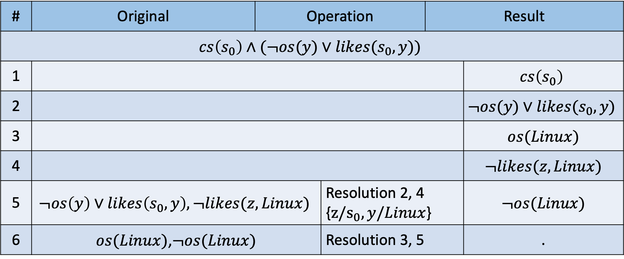
Question 5iv – SLD Resolution
Target:
$$¬likes(z, Linux)$$
# | Original | Operation |  | Result
$$cs\left(s_{0}\right)∧(¬os(y)∨likes(s_{0}, y))$$
1 |  |  |  | $$cs\left(s_{0}\right)$$ | $$cs\left(s_{0}\right)$$
2 |  |  |  | $$¬os(y)∨likes(s_{0}, y)$$ | $$¬os(y)∨likes(s_{0}, y)$$
3 |  |  |  | $$os(Linux)$$ | $$os(Linux)$$
4 |  |  |  | $$¬likes(z, Linux)$$ | $$¬likes(z, Linux)$$
5 | $$¬os\left(y\right)∨likes\left(s_{0}, y\right),¬likes(z, Linux)$$ | Resolution 2, 3 {y, Linux} | Resolution 2, 4 {$z/s_{0}, y/Linux$} |  | $$¬os(Linux)$$
6 | $os(Linux)$,$¬os(Linux)$ |  | Resolution 3, 5 |  | .

Slide 42
Question 5v
If a computer scientist likes every operating system, and Linux is an operating system then they will like Linux
Computer scientist like every OS, Linus is an OS $⊢$ computer scientist like Linux
$∃x (cs(x)∧∀y \left(os\left(y\right)→likes(x,y\right))$, $os(Linux)$ $⊢∃z likes(z, Linux)$

Slide 43
Notes
Assignment 2 packages are as follows:
Preprocessing toolkit:
https://www.nltk.org/
Modelling toolkit
https://scikit-learn.org/stable/
First-order logic: Conversion to CNF
https://april.eecs.umich.edu/courses/eecs492_w10/wiki/images/6/6b/CNF_conversion.pdf

